Slide 1

INSPECT

Slide 2
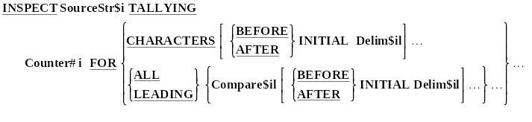
INSPECT Syntax - Format 1
INSPECT FullName TALLYING UnstrPtr
FOR LEADING SPACES.
INSPECT SourceLine TALLYING ECount
FOR ALL "e" AFTER INITIAL "start"
BEFORE INITIAL "end".

Slide 3
INSPECT Example 1
READ TextFile
AT END SET EndOfFile TO TRUE
END-READ
PERFORM UNTIL EndOfFile
PERFORM VARYING idx FROM 1 BY 1 UNTIL idx > 26
INSPECT TextLine TALLYING LetterCount(idx)
FOR ALL Letter(idx)
END-PERFORM
READ TextFile
AT END SET EndOfFile TO TRUE
END-READ
END-PERFORM
PERFORM VARYING idx FROM 1 BY 1 UNTIL idx > 26
DISPLAY "Letter " Letter(idx)
" occurs " LetterCount(idx) " times"
END-PERFORM

Slide 4
How the INSPECT works.
The INSPECT scans the Source String from left to right counting and/or replacing characters under the control of the TALLYING, REPLACING or CONVERTING phrases.
The behaviour of the INSPECT is modified by using the LEADING, FIRST, BEFORE and AFTER phrases.
An ALL, LEADING, CHARACTERS, FIRST or CONVERTING phrase may only be followed by one BEFORE and one AFTER phrase.

Slide 5
Modifying Phrases
LEADING
The LEADING phrase causes counting/replacement of all Compare$il characters from the first valid one encountered to the first invalid one.
FIRST
The FIRST phrase causes only the first valid character to be replaced.
BEFORE
The BEFORE phrase designates as valid those characters to the left of the delimiter associated with it.
AFTER
The AFTER phrase designates as valid those characters to the right of the delimiter associated with it.

Slide 6
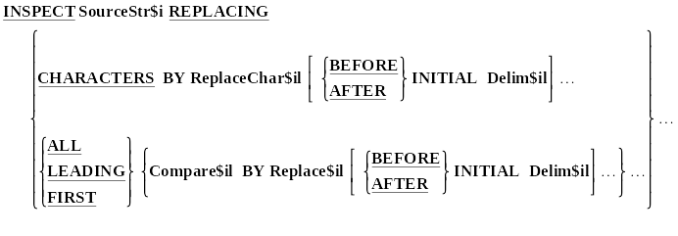
INSPECT Syntax - Format 2
PERFORM VARYING idx FROM 1 BY 1 UNTIL idx > 10
INSPECT TextLine
REPLACING SwearWord(idx) BY "*#@!"
END-PERFORM

Slide 7
INSPECT Example 2
INSPECT StringData REPLACING ALL "F" BY "G"
AFTER INITIAL "A" BEFORE INITIAL "Q".
StringData
F F F F A F F F F F Q F F F Z

Slide 8
INSPECT Example 2
INSPECT StringData REPLACING ALL "F" BY "G"
AFTER INITIAL "A" BEFORE INITIAL "Q".
StringData
F F F F A G G G G G Q F F F Z

Slide 9
INSPECT Example 3
INSPECT StringData REPLACING LEADING "F" BY "G"
AFTER INITIAL "A" BEFORE INITIAL "Z".
StringData
F F F F A F F F F F Q F F F Z

Slide 10
INSPECT Example 3
INSPECT StringData REPLACING LEADING "F" BY "G"
AFTER INITIAL "A" BEFORE INITIAL "Z".
StringData
F F F F A G G G G G Q F F F Z

Slide 11
INSPECT Example 4
INSPECT StringData REPLACING ALL "F" BY "G"
AFTER INITIAL "A" BEFORE INITIAL "Z".
StringData
F F F F A F F F F F Q F F F Z

Slide 12
INSPECT Example 4
INSPECT StringData REPLACING ALL "F" BY "G"
AFTER INITIAL "A" BEFORE INITIAL "Z".
StringData
F F F F A G G G G G Q G G G Z

Slide 13
INSPECT Example 5
INSPECT StringData REPLACING FIRST "F" BY "G"
AFTER INITIAL "A" BEFORE INITIAL "Q".
StringData
F F F F A F F F F F Q F F F Z

Slide 14
INSPECT Example 5
INSPECT StringData REPLACING FIRST "F" BY "G"
AFTER INITIAL "A" BEFORE INITIAL "Q".
StringData
F F F F A G F F F F Q F F F Z

Slide 15
INSPECT Example 6
INSPECT StringData REPLACING
ALL "FFFF" BY "FROG"
AFTER INITIAL "A" BEFORE INITIAL "Q".
StringData
F F F F A F F F F F Q F F F Z

Slide 16
INSPECT Example 6
INSPECT StringData REPLACING
ALL "FFFF" BY "FROG"
AFTER INITIAL "A" BEFORE INITIAL "Q".
StringData
F F F F A F R O G F Q F F F Z

Slide 17
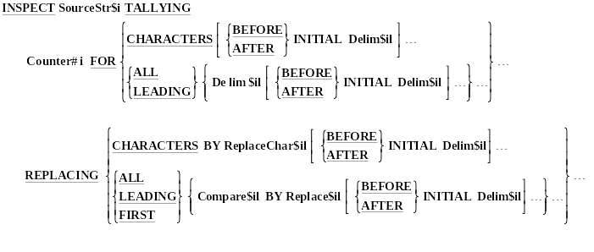
INSPECT Syntax - Format 3

Slide 18
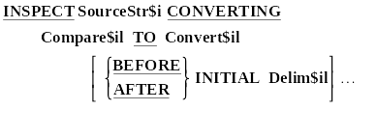
INSPECT Syntax - Format 4
INSPECT TextLine CONVERTING
"0123456789" TO "5298317046"
AFTER INITIAL "codeon"
BEFORE INITIAL "codeoff".

Slide 19
INSPECT Example 7
INSPECT StringData CONVERTING "FXTD" TO "zyab".
StringData
P X P F P D P T P P F X T D P

Slide 20
INSPECT Example 7
INSPECT StringData CONVERTING "FXTD" TO "zyab".
StringData
P y P z P b P a P P z y a b P

Slide 21
INSPECT Example 7
INSPECT StringData REPLACING "FXTD" BY "zyab".
StringData
P X P F P D P T P P F X T D P

Slide 22
INSPECT Example 7
INSPECT StringData REPLACING "FXTD" BY "zyab".
StringData
P X P F P D P T P P z y a b P

Slide 23
INSPECT Example 8
INSPECT StringData REPLACING ALL "x" BY "y"
"d" BY "z"
"f" BY "s".
StringData
P x P f P d P T P P f x T d P

Slide 24
INSPECT Example 8
INSPECT StringData REPLACING ALL "X" BY "y"
"D" BY "z"
"F" BY "s".
StringData
P y P s P z P T P P s y T z P

Slide 25
INSPECT Example 9
INSPECT CustAddress
CONVERTING "abcdefghijklmnopqrstuvwxyz"
TO "ABCDEFGHIJKLMNOPQRSTUVWXYZ".
01 AlphaChars.
02 AlphaLower PIC X(26) VALUE
"abcdefghijklmnopqrstuvwxyz".
02 AlphaUpper PIC X(26) VALUE
"ABCDEFGHIJKLMNOPQRSTUVWXYZ".
INSPECT CustAddress
CONVERTING AlphaLower TO AlphaUpper.
INSPECT CustAddress
CONVERTING AlphaUpper TO AlphaLower.

Slide 26
INSPECT Example 10
01 RussianPay PIC $$$,$$$,$$9.99.
MOVE 12345.67 TO RussianPay.
INSPECT RussianPay REPLACING ALL "$" BY "R".
DISPLAY RussianPay " roubles".
RussianPay

Slide 27
INSPECT Example 10
01 RussianPay PIC $$$,$$$,$$9.99.
MOVE 12345.67 TO RussianPay.
INSPECT RussianPay REPLACING ALL "$" BY "R".
DISPLAY RussianPay " roubles".
RussianPay
$12,345.67

Slide 28
INSPECT Example 10
01 RussianPay PIC $$$,$$$,$$9.99.
MOVE 12345.67 TO RussianPay.
INSPECT RussianPay REPLACING ALL "$" BY "R".
DISPLAY RussianPay " roubles".
RussianPay
R12,345.67

Slide 29
INSPECT Example 10
01 RussianPay PIC $$$,$$$,$$9.99.
MOVE 12345.67 TO RussianPay.
INSPECT RussianPay REPLACING ALL "$" BY "R".
DISPLAY RussianPay " roubles".
RussianPay
R12,345.67
R12,345.67 roubles

